Slide 1
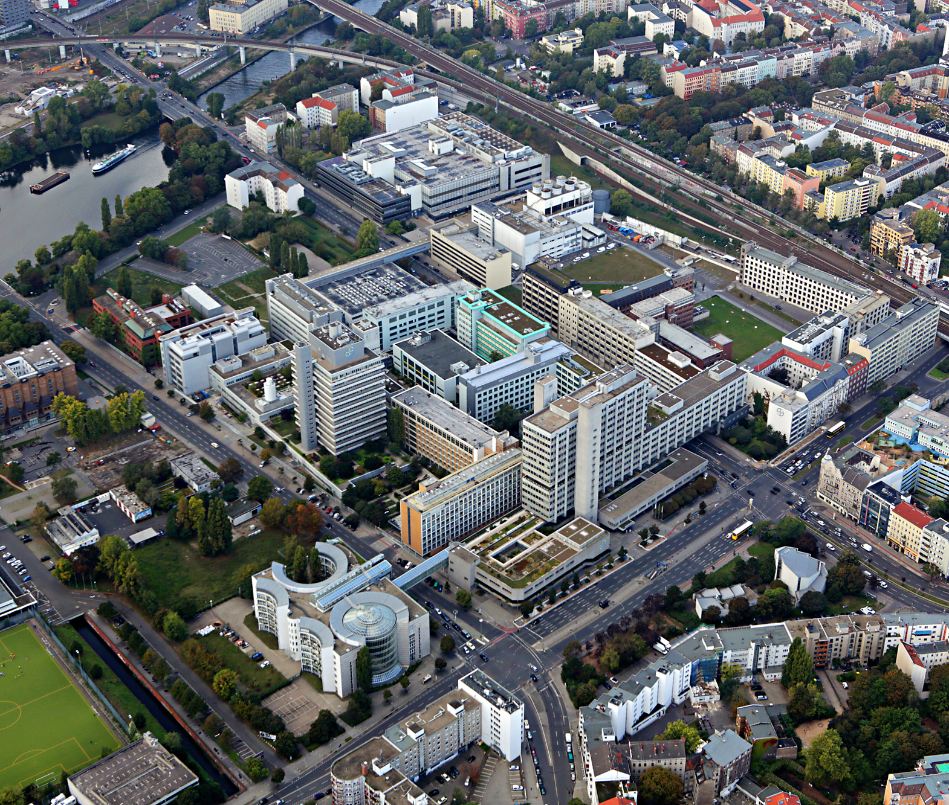
Replacing IBM Watson
Medical Coding @Bayer
13 November 2020

Slide 2
Agenda
Summary
Current Situation and Goals
Project Overview
Project Plan
Business Case
Team Overview and Required Profiles
Next Steps

Slide 3
Summary

Slide 4
Project Overview
We defined a clear objective for the project based on the identified scope and derived cost and schedule estimates
Objective of the project
The project objective is to replace IBM Watson for the 1st tier medical coding by developing and integrating state-of-the-art NLP models with approximately similar accuracy that ensures a smooth replacement by March 2022. The solution should furthermore be sustainable in terms of more use cases such as processing real world evidence which are envisioned to be included by Bayer further down the road.
Scope
Coding Algorithm Development
Architecture & Interfaces
Testing & Deployment
Develop Medical Coding algorithm for Clinical Trials (Medical History& Adverse Events) data
Not in Scope:
WhoDD Coding
Pharmacovigilance (MH&AE) Coding
Design and build Architecture and Pipeline for a Cloud-based Machine Learning solution
Define and build Interfaces to current Medical Coding platform (MatchPoint Coder)
User Testing with Medical Coding Team
GxP Validation (Change request to MPC)
Deployment of developed algorithms into existing IT infrastructure and Medical Coding processes
(Complete) Decommission of IBM Watson
Estimated Schedule
Cost Estimate
Kick-off: January 2021
Phase 1: January 2021 – March 2021 (2.5 months)
Phase 2: March 2021 – December 2021 (9.5 months)
Phase 3: January 2022 – May 2022 (5 months)
End of Transition Phase: May 2022 (17 months total)
(approval pending)
Phase 1:
Phase 2:
Phase 3:
Total:
200.000 €
1.121.700 €
263.700 €
1.585.400 €

Slide 5
Goals & Benefits
Watson’s replacement offers great opportunities which are also in line with Bayer’s superior strategy
Reduce run cost of medical coding software by avoiding high annual license fees
Utilize most recent advances in NLP domain to increase accuracy for medical coding
Take advantage of available in-house skills, i.e. NLP Experts and Medical Coder
Enable future use cases such as medical coding of Real World Data
Ensure available Business IP stays within Bayer and develop new IP, i.e. capitalization of algorithms and/or patents
The goals and benefits that replacing IBM Watson aims at
are aligned with and contribute to key strategic programs. This
includes the central coding approach where Bayer is unique
as well as the Digital Roadmap.

Slide 6
Important Parameters
There are certain dates and details that determine the project timeline
IBM Watson Contract
The contract with IBM expires on 31 March 2022. In case it should be renewed, a Purchas Order must be placed at least 90 days prior to expiration. This requires internal decision processes and contract negotiations with IBM and therefore it is crucial to consider this with regard to the project timeline.
Budget impact
Due to the current situation at Bayer, budget considerations for 2021 are ongoing. However, the complexity of the task and the expiration of Watson’s contract mandate a start of activities in January 2021. This ensures enough time to avoid further license fees to IBM as of 2022.
MedDRA Updates
The MedDRA maintenance organization releases new versions of the dictionary twice a year, on 1 March and 1 September. The required changes need to be implemented on the first Monday of May and November, respectively. This hast to be considered when planning model development and deployment.

Slide 7




Project Plan Draft
3 Phases | 17 Months of Activities | Go-Live in November 2021
2021
2022
Jan
Febr.
März
Apr.
Mai
Juni
Juli
Aug.
Sept.
Okt.
Nov.
Dez.
Jan.
Febr.
März
Apr.
Mai
WP1: Project Management
WP2: Data Assessment and Model Exploration
2.1: Assessment of Data and Requirements
2.2: Define Baseline Model and Evaluation criteria
WP3: Model Building and Refinement
3.1: CT-MH Model Development
3.2: CT-AE Model Development
3.3: Automatic Re-Training Development
WP4: Architecture and Interfaces
4.1 Architecture Conceptualizing & Building
4.2 MPC Interface Development
4.3 Model Integration
WP5: Testing and Deployment
5.1 Integration
5.2 UAT
5.3 Deployment
WP6: Hypercare and Documentation
6.1 Hypercare
6.2 Decommissioning of IBM Watson
6.3 Project Documentation
New MedDRA Version Releases
Go-live
CT models
Decision about
IBM Watson
Kickoff
Budget Release
decision
Project Completion
Phase 1
Phase 2
Phase 3

Slide 8
Project Overview - Work Packages
There are six major Work Packages with specific outcomes and effort estimates
Short Description
Outcome
Effort and Cost Estimate
WP1
Project Management
Manage project and activities
Coordinate available resources
Ensure compliance with internal processes
Enablement and facilitation of team activities
Project documentation and communication of results
Risks are continuously monitored and can be mitigated in time
PD: 346
Costs: 345.400 €
WP2
Data Assessment &
Model Exploration
Develop understanding for data and requirements
Assess previous work
Define baseline and metrics
Relevant data available
Baseline model and evaluation criteria are defined
Promising approaches for Model development are evaluated
PD: 152
Costs: 119.900 €
WP3
Model Building & Refinement
Building AI models for medical coding
Develop automatic update solution for new MedDRA versions
AI Models for different Clinical Trials terms (MH&AE) coding
Automatic integration of MedDRA updates
PD: 634
Costs: 550.800 €
WP4
Architecture & Interfaces
Design and build cloud environment including necessary interfaces
Documentation according to Bayer requirements
Cloud based infrastructure and interfaces with MPC
GxP compliant documentation and validation
PD: 252
Costs: 245.400 €
WP5
Testing & Deployment
Testing and validation of new system
Integration and Deployment
Successfully performed UAT as well as integration and validation testing
Successful Deployment and Go-Live
Complete set of validation documents
PD: 375
Costs: 276.400 €
WP6
Hypercare & Documentation
Disconnecting IBM Watson from the coding environment
Monitoring the new system
Close the project
IBM Watson successfully decommissioned
Stable new system
Full project documentation
PD: 65
Costs: 54.500 €

Slide 9
Project Overview – Guiding Principles
Key points that determine the development process
CHANGE DIMENSIONS
WAYS OF WORK
As the MatchPoint Coder currently interacts with IBM Watson via an interface, no major changes should be made to the MPC itself. The interface between MPC and the new system should therefore be as similar as possible to the old one to ensure a “minimal-invasive” approach to MPC. There will be no change to any business processes due to this project.
To ensure flexibility and minimize reaction times to emerging risks and issues, the development of the new system should be organized in two- or three-week sprints. Those include sprint planning and review sessions with selective participation of SMEs and Stakeholders.
First objective is to replace IBM Watson, not necessarily to outperform it in the beginning
REQUIREMENTS
METHODS
The requirements for the new system are based on the original IBM Watson ones. However, they were adjusted due to reduced scope and minor additional features. They build the foundation for the development phase and need to be aligned on with all team members.
The ambition and expectations with regard to the new system is that it uses state-of-the-art AI methods wherever appropriate. This should contribute to Bayer’s Digital Roadmap as well as to the vision to include future Use Cases such as coding real world evidence, thus providing a sustainable coding engine.
STAKEHOLDER INVOLVEMENT
QUALITY CONTROL
Medical Coding is a complex task that requires highly skilled human resources. For a computer model to perform well on such a task, it needs to incorporate the knowledge, especially when it comes to specific differences, e.g. between CT & AE term types. Therefore, it is essential to involve business stakeholders in evaluation and feedback loops.
As the project takes place in an GxP-relevant environment, validation and process compliance hast to be monitored and ensured constantly.

Slide 10
Major Risks and Dependencies
Emerging and present risks and dependencies need to be considered, anticipated and mitigated – starting now
Budget Risk
Time Risk
Quality Risk
The pending 200.000€ budget for 2021 is estimated to last for the first 2.5 months of project activity. Additional budget is therefore required and approval of such should be prioritized in order to avoid any delays and ensure project continuity.
IBM Watson’s contract expiration sets a hard deadline for developing and implementing a new coding solution. Even a one year extension should be avoided due to additional cost.
Hence, any delays with regard to the outlined schedule pose an imminent risk for the overall project success and should be avoided.
Developing and implementing state-of-the-art machine learning methods is always subject to certain risks of failure. Most recent research results that seem promising at first can turn out to not be performing well on the actual available data and vice versa. The chosen approach should therefore continuously be evaluated and adjusted, if necessary.
Risks
Available Resources and Staffing
Access to relevant data
Due to the tight schedule and the project’s complexity, many resources from different departments (Business, IT, external) need to be involved, during peak times at full capacity.
Hence, it is essential to already communicate capacity needs and initiate a transparent staffing process.
The performance of the new coding model is highly dependent on the available training data. This includes AutoCoder inputs- and outputs as well as final results of the coding process. Also data from intermediate steps, such as Watson’s five proposals or initiated queries will be required.
Furthermore, additional data such as Clinical Trials full data or electronic health records might be required for language model fine-tuning. This might oblige additional data preparation steps which need to be anticipated adequately.
Dependencies

Slide 11
Business Case
The cost and effort estimates result in a positive Business Case, further supported by qualitative benefits
Quantitative
Qualitative
Cost | 2021 | 2022 | 2023 | 2024 | 2025 | 2026 | Total
One time cost | 1.321.700 € | 263.700 € |  |  |  |  | 1.585.400 €
Run cost |  | 60.000 € | 60.000 € | 60.000 € | 60.000 € | 60.000 € | 300.000 €
Total* | 1.321.700 € | 323.700 € | 60.000 € | 60.000 € | 60.000 € | 60.000 € | 1.885.400 €
Support Digital Roadmap through expanding Bayer’s internal AI skills and expertise
Ensure available Business IP stays within Bayer and further develop new IP, i.e. AI algorithms and/or patents
*Not included in estimates are one-time and run cost for cloud resources as they are controlled centrally. They are estimated with ~40.000€ per year.
Utilize most recent advances in NLP domain to increase accuracy for medical coding
Benefits | 2021 | 2022 | 2023 | 2024 | 2025 | 2026 | Total
Additional revenue | - € | - € | - € | - € | - € | - € | - €
Savings | - € | 532.995 € | 532.995 € | 532.995 € | 532.995 € | 532.995 € | 2.664.975 €
Cost Avoidance |  | 79.949 € | 79.949 € | 79.949 € | 79.949 € | 79.949 € | 399.746 €
Total |  |  |  |  |  |  | 3.064.721 €
Enable future use cases such as medical coding of Real World Data
Reduce dependency from external vendors to allow for further development and improvement
Pay-Back Period (in years) | 3,31 | Net Present Value | 489.207 €

Slide 12
Next Steps
With the proposed project start being only 6 weeks away, internal initialization has to start now
Request and secure budget for 2021 and 2022 to avoid delays in project delivery
Determine available employee resources and identify needs for external support
Involve relevant stakeholders and close information gaps (e.g. regarding cloud infrastructure)
Gather relevant AutoCoder and omissions data and identify further data sources
Prepare project kick-off and set up project management
Validate User Requirements and Effort Estimates, adjust when necessary
Initiate further initiatives required for a full replacement of IBM Watson (e.g. UMC Drug Coding PoC)
Start negotiations with IBM regarding a 1-year extension to have a fallback option and sharpen Business Case

Slide 13
Current Situation & Goals

Slide 14

Current Situation – Starting Point
To meet regulatory requirements and to speed up medical coding processes, Bayer is currently using IBM Watson as an external software service.
This results in high costs due to annual fees for IBM which are likely to increase after the expiration of the initial contract
Also, Bayer has to share in-depth knowledge regarding the medical coding process and its standards with IBM on a continuous basis while no major updates have been made to the Watson coding algorithm since implementation
At the same time, Bayer AG employees are highly skilled and would allow developing and running an in-house solution, resulting in considerations about replacing IBM and developing such a solution
The goal of this project was therefore to evaluate and conceptualize the development of an in-house solution for medical coding with respect to cost, people and technology

Slide 15
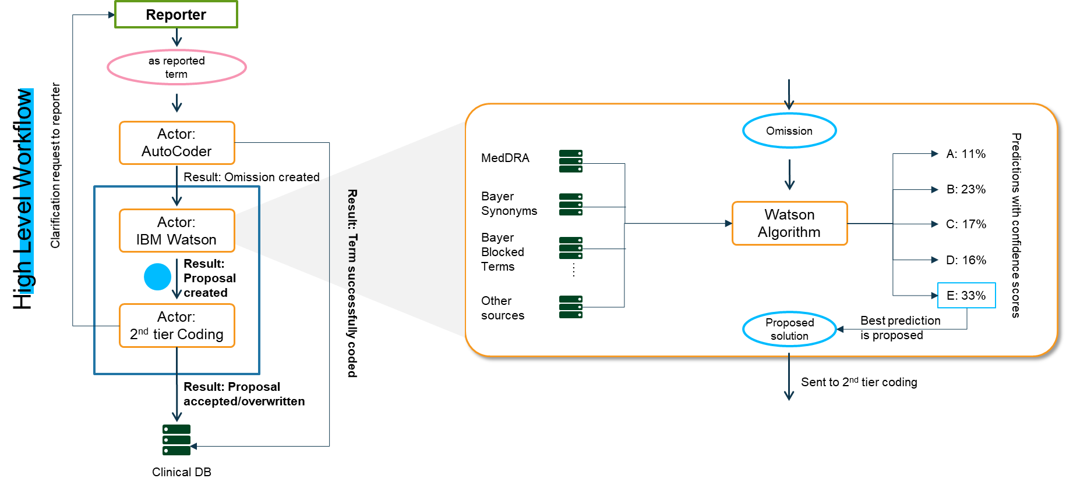
Current Situation – Medical Coding with IBM Watson
The Medical Coding process is highly dependent on Watson, yet there are major issues coming along
The high-level medical coding workflow ensures regulatory conformity as well as consistency. While the rule-based AutoCoder is able to encode 45-50% of reported terms successfully, the omissions that are left are processed via a “Four-eyes-approach” where IBM Watson proposes solutions subject to approval through a human medical coder.
As of today, IBM Watson is used for proposing solutions to terms generated from Clinical Trials and Pharmacovigilance data based on both, the MedDRA and WhoDD dictionaries. The total volume of terms processed by Watson is about 55.000-60.000 terms per month and while the accuracy for PV data is above 90%, the CT accuracy falls well behind that with around 75%.
IBM Watson main issues
With the ending of the initial 5 years contract period on 31 March 2022, the high license fees of about 530.000€ per year are expected to increase by up to 30% resulting in a not justifiable cost-benefit balance
Quality
(Future) Costs
Since its full implementation in April 2017, IBM did not improve the coding algorithm, nor are they planning to do so. At the same time, Watson struggles with rather basic issues such as spelling mistakes that lead to wrong proposals. However, Bayer has no insights or access to the algorithm which can be considered as a Blackbox.

Slide 16
Current Situation – Advances in NLP domain
2014
Sequence-to-Sequence models
Since the start of Watson‘s PoC phase, NLP has come a long way
Enabled by deep learning and rapid increase in computational power, the Natural Language Processing domain witnessed unprecedented leaps over the last decade, resulting in state-of-the-art models and architectures
Memory-based networks
2015
2015
Attention
The introduction of the attention mechanism in 2015 was key for a broad range of new model architectures such as BERT or XLNet that outperform previous approaches on all relevant NLP tasks
Main advantage of recent language models is sensitivity to context and semantics, which allows to differentiate between two or more meanings of the same word (e.g. Apple, the fruit and Apple, the Company)
Transformer
2017
Most importantly in the context of this project, latest language models can and have been fine-tuned for usage in domains that are sensitive to specific vocabularies, such as medicine, biology or law. This results in highly accurate and domain-specific word representations which are likely to increase performance of downstream tasks such as Medical Coding.
2018
BERT
It can be expected that developing in-house solution with state-of-the-art NLP models not only allows for better results but also enables Bayer to constantly improve model performance without being dependent on external vendors
GPT-2
2019
2019
XLNet
GPT-3
2020
Notes:
https://blog.exxactcorp.com/deep-learning-in-natural-language-processing-history-and-achievements/

Slide 17
Goals & Benefits
Watson’s replacement offers great opportunities which are also in line with Bayer’s superior strategy
Avoid low performance sites
The time to make informed decisions
The internal and external cost saving
The adoption of PoC for the new studies
Ensure available Business IP stays within Bayer and develop new IP, i.e. capitalization of algorithms and/or patents
The goals and benefits that replacing IBM Watson aims at
are aligned with and contribute to key strategic programs. This
includes the central coding approach where Bayer is unique
as well as the Digital Roadmap.

Slide 18
Project Overview

Slide 19
Project Overview
We defined a clear objective for the project based on the identified scope and derived cost and schedule estimates
Objective of the project
The project objective is to replace IBM Watson for the 1st tier medical coding by developing and integrating state-of-the-art NLP models with approximately similar accuracy that ensures a smooth replacement by March 2022. The solution should furthermore be sustainable in terms of more use cases such as processing real world evidence which are envisioned to be included by Bayer further down the road.
Scope
Coding Algorithm Development
Architecture & Interfaces
Testing & Deployment
Develop Medical Coding algorithm for Clinical Trials (Medical History& Adverse Events) data
Not in Scope:
WhoDD Coding
Pharmacovigilance (MH&AE) Coding
Design and build Architecture and Pipeline for a Cloud-based Machine Learning solution
Define and build Interfaces to current Medical Coding platform (MatchPoint Coder)
User Testing with Medical Coding Team
GxP Validation (Change request to MPC)
Deployment of developed algorithms into existing IT infrastructure and Medical Coding processes
(Complete) Decommission of IBM Watson
Estimated Schedule
Cost Estimate
Kick-off: January 2021
Phase 1: January 2021 – March 2021 (2.5 months)
Phase 2: March 2021 – December 2021 (9.5 months)
Phase 3: January 2022 – May 2022 (5 months)
End of Transition Phase: May 2022 (17 months total)
(approval pending)
Phase 1:
Phase 2:
Phase 3:
Total:
200.000 €
1.121.700 €
263.700 €
1.585.400 €

Slide 20
Project Overview - Work Packages
There are six major Work Packages with specific outcomes and effort estimates
Short Description
Outcome
Effort Estimate
WP1
Project Management
Manage project and activities
Coordinate available resources
Ensure compliance with internal processes
Enablement and facilitation of team activities
Project documentation and communication of results
Risks are continuously monitored and can be mitigated in time
PD: 346
Costs: 345.400 €
WP2
Data Assessment &
Model Exploration
Develop understanding for data and requirements
Assess previous work
Define baseline and metrics
Relevant data available
Baseline model and evaluation criteria are defined
Promising approaches for Model development are evaluated
PD: 152
Costs: 119.900 €
WP3
Model Building & Refinement
Building AI models for medical coding
Develop automatic update solution for new MedDRA versions
AI Models for different Clinical Trials terms (MH&AE) coding
Automatic integration of MedDRA updates
PD: 634
Costs: 550.800 €
WP4
Architecture & Interfaces
Design and build cloud environment including necessary interfaces
Documentation according to Bayer requirements
Cloud based infrastructure and interfaces with MPC
GxP compliant documentation and validation
PD: 252
Costs: 245.400 €
WP5
Testing & Deployment
Testing and validation of new system
Integration and Deployment
Successfully performed UAT as well as integration and validation testing
Successful Deployment and Go-Live
Complete set of validation documents
PD: 375
Costs: 276.400 €
WP6
Hypercare & Documentation
Disconnecting IBM Watson from the coding environment
Monitoring the new system
Close the project
IBM Watson successfully decommissioned
Stable new system
Full project documentation
PD: 65
Costs: 54.500 €

Slide 21
Project Overview – Guiding Principles
Key points that determine the development process
CHANGE DIMENSIONS
WAYS OF WORK
As the MatchPoint Coder currently interacts with IBM Watson via an interface, no major changes should be made to the MPC itself. The interface between MPC and the new system should therefore be as similar as possible to the old one to ensure a “minimal-invasive” approach to MPC. There will be no change to any business processes due to this project.
To ensure flexibility and minimize reaction times to emerging risks and issues, the development of the new system should be organized in two- or three-week sprints. Those include sprint planning and review sessions with selective participation of SMEs and Stakeholders.
First objective is to replace IBM Watson, not necessarily to outperform it in the beginning
REQUIREMENTS
METHODS
The requirements for the new system are based on the original IBM Watson ones. However, they were adjusted due to reduced scope and minor additional features. They build the foundation for the development phase and need to be aligned on with all team members.
The ambition and expectations with regard to the new system is that it uses state-of-the-art AI methods wherever appropriate. This should contribute to Bayer’s Digital Roadmap as well as to the vision to include future Use Cases such as coding real world evidence, thus providing a sustainable coding engine.
STAKEHOLDER INVOLVEMENT
QUALITY CONTROL
Medical Coding is a complex task that requires highly skilled human resources. For a computer model to perform well on such a task, it needs to incorporate the knowledge, especially when it comes to specific differences, e.g. between CT & AE term types. Therefore, it is essential to involve business stakeholders in evaluation and feedback loops.
As the project takes place in an GxP-relevant environment, validation and process compliance hast to be monitored and ensured constantly.

Slide 22
Major Risks and Dependencies
Emerging and present risks and dependencies need to be considered, anticipated and mitigated – starting now
Budget Risk
Time Risk
Quality Risk
The pending 200.000€ budget for 2021 is estimated to last for the first 2.5 months of project activity. Additional budget is therefore required and approval of such should be prioritized in order to avoid any delays and ensure project continuity.
IBM Watson’s contract expiration sets a hard deadline for developing and implementing a new coding solution. Even a one year extension should be avoided due to additional cost.
Hence, any delays with regard to the outlined schedule pose an imminent risk for the overall project success and should be avoided.
Developing and implementing state-of-the-art machine learning methods is always subject to certain risks of failure. Most recent research results that seem promising at first can turn out to not be performing well on the actual available data and vice versa. The chosen approach should therefore continuously be evaluated and adjusted, if necessary.
Risks
Available Resources and Staffing
Access to relevant data
Due to the tight schedule and the project’s complexity, many resources from different departments (Business, IT, external) need to be involved, during peak times at full capacity.
Hence, it is essential to already communicate capacity needs and initiate a transparent staffing process.
The performance of the new coding model is highly dependent on the available training data. This includes AutoCoder inputs- and outputs as well as final results of the coding process. Also data from intermediate steps, such as Watson’s five proposals or initiated queries will be required.
Furthermore, additional data such as Clinical Trials full data or electronic health records might be required for language model fine-tuning. This might oblige additional data preparation steps which need to be anticipated adequately.
Dependencies

Slide 23
Project Plan

Slide 24
Important Parameters
There are certain dates and details that determine the project timeline
IBM Watson Contract
The contract with IBM expires on 31 March 2022. In case it should be renewed, a Purchas Order must be placed at least 90 days prior to expiration. This requires internal decision processes and contract negotiations with IBM and therefore it is crucial to consider this with regard to the project timeline.
Budget impact
Due to the current situation at Bayer, budget considerations for 2021 are ongoing. However, the complexity of the task and the expiration of Watson’s contract mandate a start of activities in January 2021. This ensures enough time to avoid further license fees to IBM as of 2022.
MedDRA Updates
The MedDRA maintenance organization releases new versions of the dictionary twice a year, on 1 March and 1 September. The required changes need to be implemented on the first Monday of May and November, respectively. This hast to be considered when planning model development and deployment.

Slide 25
Project Plan Draft
3 Phases | 17 Months of Activities | Go-Live in November 2021
2021
2022
Jan
Febr.
März
Apr.
Mai
Juni
Juli
Aug.
Sept.
Okt.
Nov.
Dez.
Jan.
Febr.
März
Apr.
Mai
WP1: Project Management
WP2: Data Assessment and Model Exploration
2.1: Assessment of Data and Requirements
2.2: Define Baseline Model and Evaluation criteria
WP3: Model Building and Refinement
3.1: CT-MH Model Development
3.2: CT-AE Model Development
3.3: Automatic Re-Training Development
WP4: Architecture and Interfaces
4.1 Architecture Conceptualizing & Building
4.2 MPC Interface Development
4.3 Model Integration
WP5: Testing and Deployment
5.1 Integration
5.2 UAT
5.3 Deployment
WP6: Hypercare and Documentation
6.1 Hypercare
6.2 Decommissioning of IBM Watson
6.3 Project Documentation
New MedDRA Version Releases
Go-live
CT models
Decision about
IBM Watson
Kickoff
Budget Release
decision
Project Completion
Phase 1
Phase 2
Phase 3

Slide 26
Project Initialization
Work Package 0 | Currently ongoing
Objective
In order to initialize the project, detailed planning of time, budget and resources has to be performed as well as risk assessments and an overall project evaluation. Furthermore, important parameters such as scope and infrastructure decisions need to be defined.
Main Activities
Project Planning
IT & Data
Define Scope with Business stakeholders
Plan time, budget and resource needs and allocations
Determine needs for Third-party vendors and initiate requests accordingly
Perform risk assessment and mitigations
Prepare preparation kickoff and communicate with stakeholders
Perform project evaluation regarding strategic fit, compliance and value (tbd if still necessary)
Perform initial infrastructure assessment in terms of which platform is suitable
Address IT-Security and Data privacy issues
Gather necessary data and information needed for project start
Involved Stakeholders
Outcomes
Project Manager
Project Manager
Business Stakeholder
Data Science Team(s) (as required)
SMEs (as required)
Time, budget and resources plans are available and validated with relevant stakeholders
Necessary parameters such as scope and infrastructure decisions are defined
Risks are identified and can be mitigated
Relevant data is available

Slide 27
Project Management
Work Package 1 | Continuous Activities
Objective
The objective of this Work Package is to manage the project and its activities, coordinate available resources and ensure compliance with internal processes to facilitate the overall project success.
Main Activities
Project Oversight
SOP Compliance & Documentation
Stakeholder communications & support
Responsible for delivering the project in time and budget considering the scope
Coordinating resources and timetables with stakeholders, lead workshops
Managing project progress, assessing risks and adapt project work as required
Ensure project compliance and proper documentation (incl. GxP validation)
Planning and leading of Kick-off Workshop, User Testing & Deployment
Provide team members with needed information & data
Communicate project status to Management/Business stakeholders
Involved Stakeholders
Outcomes
Project Manager
Enablement and facilitation of team activities
Project documentation and communication of results is in line with internal requirements and stakeholder expectations
Risks are continuously monitored and can be mitigated in time

Slide 28
Data Assessment and Model Exploration
Work Package 2 | January – February 2021
Objective
In Work Package 2, the objective is to develop a surrounding understanding of the available data, assess previous work such as IBM Watson & PoC results and build a baseline model with specific evaluation criteria that serve as measurement for future model results.
Main Activities
Assess Data and previous work
Build baseline model
Define evaluation criteria and hypotheses
Gather available and relevant data
Develop an understanding for User Requirements and data
Review PoC Sprint results from 2019 and evaluate results
Review IBM Watson performance
Develop initial data ingestion pipeline
Based on model trade-off considerations and scope, build baseline model (e.g. on PoC sprint results)
Evaluate baseline model and derive potential for “Quick wins”
Based on IBM Watson accuracy, scope and model trade-off considerations, decide on metrics for evaluation (e.g. LLT vs PT, F1 Score vs. Accuracy, etc.)
Define hypotheses that guide model development
Involved Stakeholders
Outcomes
Data Science Team(s)
Project Manager (as required)
Business Stakeholder (as required)
All relevant data for model training, testing and validation is available
A baseline model as well as evaluation criteria are defined and serve as a foundation for all further models
With respect to scope and model trade-off considerations, most promising approaches are identified for model development

Slide 29
Deep Dive: WP2 - Data Assessment and Model Exploration
Key questions when assessing and exploring data
Data availability:
Is all data that is required, such as omissions dataset, IBM Watson results, dictionaries, present?
Are quality and quantity of the data sufficient?
Data distribution:
How is the data distributed over MedDRA classes?
Which are classes that are quite rare and why?
Are certain classes more important than others?
Output exploration:
What patterns can be identified within the omissions data?
Where do Watson and the AutoCoder struggle? Systematic Error(s)?
How is Watson accuracy determined (LLT vs. PT Level)?
Coding specifics & user requirements:
Which implications do the Bayer coding standards have on the data and future models?
Which user requirements can be more easily or more difficult be implemented?
Model hypotheses:
Which approach seems most promising for quick wins?
Which implications do different approaches have on additional data needs?
Which measures seem reasonable for model evaluation (Recall, Precision, Accuracy, F1-Score)?

Slide 30
Model Building and Refinement
Work Package 3 | February 2021 – April 2022
Objective
Considering the results from Work Package 2, the objective in this Work Package is to build sustainable models that incorporate state-of-the-art NLP methods for Clinical Trials term coding
Main Activities
Medical History model development
Adverse Events model development
Automatic Integration of MedDRA Updates
Based on selected approaches, build first MVP model and evaluate result
Using hypotheses and evaluation criteria, refine model to improve accuracy
Implement MedDRA version update
Based on selected approaches, build first MVP model and evaluate result
Using hypotheses and evaluation criteria, refine model to improve accuracy
Implement MedDRA version update
Develop approach for automatic integration of biyearly MedDRA Updates to reduce manual effort
Test and validate results with Medical Coding Team
Involved Stakeholders
Outcomes
Data Science Team(s)
Project Manager (as required)
Business Stakeholder (as required)
Models for different Clinical Trials terms (MH&AE) that can be implemented in the Medical Coding processes
Solution that enables automatic integration of MedDRA updates

Slide 31
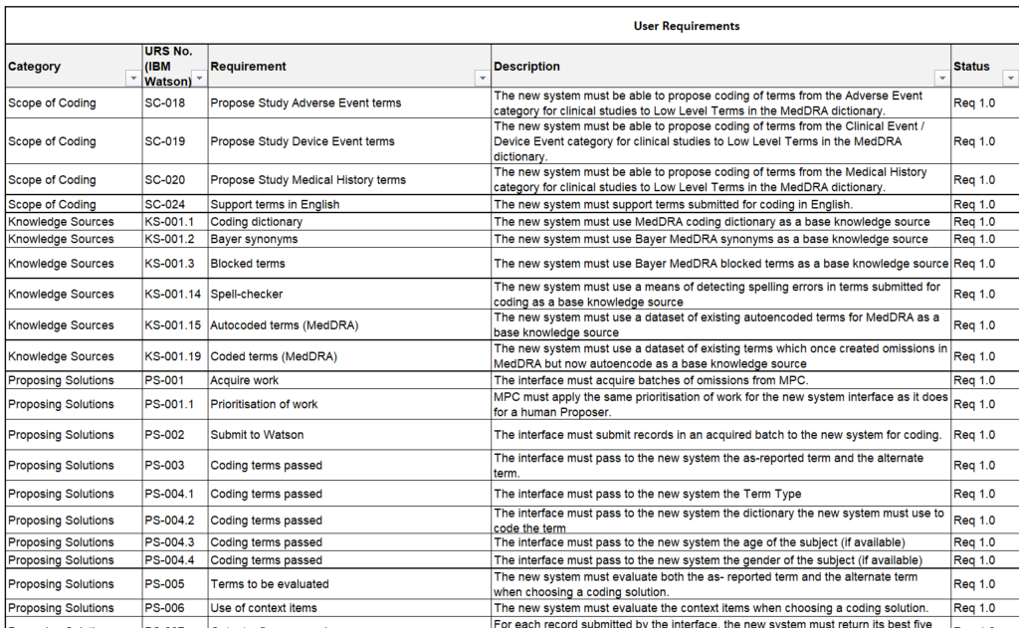
Deep Dive: WP3 - User Requirements
Based on the Scope and Watson User Requirements, we derived requirements for the new system
Discarded Requirements
The overall requirements of IBM Watson are still up to date and can be adopted for the new system. However the difference in scope of the new system with respect to PV and drug data results in an adjusted URS document. All requirements that remain for the new system have been aligned to the new scope and validated with business stakeholders.
Additional Requirements
As a result from various stakeholder interviews, an additional requirement has been added. The new system is therefore required to not simply make suggestions, as bad as they may be, but to also suggest to initiate a query to ask for additional information. In the long run, it should also be possible to initiate queries automatically once query formulations have been standardized.
The User Requirements build the foundation for the development phase with regard to features and functionalities.
They need to be communicated to and aligned on with all team members and stakeholders.

Slide 32
Deep Dive: WP3 - Model Building and Refinement
There are different promising approaches that need to be evaluated carefully
Rule based
Embedding Models
Hierarchical Approach
Hybrid Models
Exemplary
Process omissions created by AutoCoder to correct spelling errors and either feed them back to AutoCoder or process them separately.
Use unsupervised machine learning to classify omissions utilizing embeddings and state-of-the-art language models and/or word distance measures.
Utilizing the MedDRA dictionary hierarchy to conduct a step-wise classification, e.g. using embedding models
Combine rule-based approaches with state-of-the art models to uplift accuracy and performance.
Hypotheses
Hypotheses
Hypotheses
Hypotheses
AutoCoder cannot encode many terms due to spelling errors and abbreviations
There are underlying and systematic errors within the omission data that can efficiently be addressed with additional rules
There is too little context in input data to reasonably utilize embeddings
Older models such as GloVe work might suffice
The information provided in the MedDRA hierarchy is valuable and can be utilized
Step-wise iterations improve classification accuracy due to less classes and dependencies
Combining different approaches iteratively will lead to better accuracy
Adjusting weights between rules and semantics leads to similar performance as IBM Watson
Methods
Methods
Methods
Methods
Text Mining
Fuzzy string matching
Utilizing Synonyms and Hyponyms
Pattern Recognition
Embedding models (e.g., GloVe, BERT)
Deep Learning
Dimension Reduction
Distance measures (e.g., Word Mover’s Distance, cosine similarity)
Utilizing hierarchy and ontology
Machine Learning
Bayesian tree classification
Rule based string matching
Embedding models
Distance measures
Ensemble learning
Opportunities | Risks | Effort
Quick improvement of accuracy scores, Explainable and thus easier to adjust/finetune | Very static, might be incompatible with future MedDRA updates, too many rules required | Low, requires through understanding of underlying data to derive stable rules, fast initial implementation
Opportunities | Risks | Effort
Might prove more stable with respect to MedDRA Updates, Embeddings can be trained task-specific | Too little context can lead to weak performance | Medium, needs advanced knowledge of Semantics & Deep Learning; fine-tuning of embedding models needed
Opportunities | Risks | Effort
Available information in hierarchy can prove being valuable for classification | Very vulnerable to MedDRA hierarchy changes which can lead to high recalibration efforts | High, deep domain knowledge required, many iterations and models likely needed
Opportunities | Risks | Effort
Combination of different approaches likely to increase overall accuracy and performance | Complexity increases while issues of all approaches need to be addressed together | High, due to iterative adjustments and complexity which requires time and both, broad and deep expertise

Slide 33
Deep Dive: WP3 - Model Building and Refinement
To refine the model in terms of accuracy, applying a iterative – build, measure, learn approach is key
Questions regarding NLP models & architecture:
Exemplary
Methods: Which methods can be combined or stacked to improve performance?
Subclasses: Which MedDRA classes perform best for which term groups (AE vs. MH)?
Performance: Which model architectures perform best and why?
Architecture implications: What kind of services is necessary for deploying the model (e.g. Docker, SageMaker, etc.) ?
Interface: Which changes need to be implemented to the MPC interface – if any?
….
Feedback Loops with technical & NLP SMEs
Measure
Questions regarding User Requirements:
Build
Learn
Features: Which features from the User Requirements are to be prioritized and why?
Error patterns: What kind of terms seem to be categorized wrong most often ?
Further data collection: What further data points can be collected in order to offer value-added services?
….
Exemplary
Applying a iterative – build, measure, learn approach
Feedback Loops with Business SMEs

Slide 34
Architecture and Interfaces
Work Package 4 | April – October 2021
Objective
The objective of this Work Package is design and build a stable cloud environment for the new coding system including necessary interfaces.
Main Activities
Architecture & Infrastructure
MPC Interface Development
Model Integration
Review current IT architecture and assess Technical Requirements
Draft future architecture of system, including interface to MPC & data pipeline
Develop cloud infrastructure & maintenance processes
Based on architecture draft, develop, test and validate interface between MPC and new system
Document required changes according to GxP validation process
Build model-pipelines (including re-training loops) and integrate model in cloud environment
Test and validate model pipeline
Provide documentation for architecture, model and pipelines
Involved Stakeholders
Outcomes
Lead Architect
ML/Cloud Engineer
IT System Owner
Project Manager
Validation SME
Business Stakeholder (as required)
Cloud based infrastructure that is in line with User Requirements and internal IT requirements (e.g. GxP)
Documentation of different components such as pipelines, architecture, etc.
Validated interface between MatchPoint Coder and new system

Slide 35
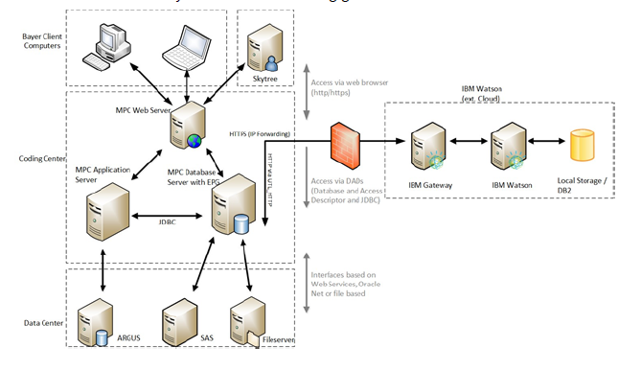
Deep Dive: WP4 - Architecture and Interfaces
Due to the planned replacement of IBM Watson, changes to the current architecture will be necessary
Today
2022
Bayer In-House
Medical Coding
Solution for CT
Skytree
WhoDD
MPC Application
Server
MPC Web Server
Illumin.ai
MPC DB
Server
with EPG
ARGUS
SAS
Fileserver
Today, coding of CT, PV and drug data is conducted via IBM Watson interface only
For Japanese terms, Skytree is being used
New Bayer In-House Medical Coding is proposing solutions for CT terms only
PV data is coded via Illumin.ai system
WhoDD API is used for drug data coding
For Japanese terms, Skytree is still in place
External System
New Bayer System

Slide 36
Testing and Deployment
Work Package 5 | April – November 2021
Objective
Ensure MatchPoint Coder system is compliant after integration of the new system. This includes all relevant testing and validation efforts according to compliance standards as well as a successful deployment and Go-Live.
Main Activities
Integration and Validation Testing
User Acceptance Testing
Deployment and Go-Live
Develop test plans for integration and validation testing based on internal best-practices and requirements
Conduct integration and validation testing
Evaluate and document results according to GxP standards
Develop test plan and prepare User Acceptance Testing considering stakeholder expectations and availabilities
Conduct User Acceptance Test
Evaluate and document results
Develop cutover and roll back plans for Go-Live
Request and gather internal reviews and approvals
Prepare and manage Go-Live
Involved Stakeholders
Outcomes
Data Science Team(s)
ML/Cloud Engineer
IT System Owner
Project Manager
Validation SME
Business Stakeholder (as required)
Successfully performed UAT as well as integration and validation testing
Successful Deployment and Go-Live of new system
Complete set of validation documents

Slide 37
Hypercare and Documentation
Work Package 6 | December 2021 – May 2022
Objective
Main focus of Work Package 6 are downstream tasks such as successfully disconnecting IBM Watson from the coding environment, monitoring the new system and close the project. The objective is to have a system that runs stable and a well-documented project closure.
Main Activities
Decommissioning of IBM Watson
Hypercare of new system
Project Documentation
Shutdown IBM Watson interface
Monitor new system performance and operations
Manage issues and bug fixes as required
Document Lessons Learned
Initiate official Project Closure
Involved Stakeholders
Outcomes
Data Science Team(s)
Project Manager
IT System Owner
ML/Cloud Engineer
Validation SME
Business Stakeholder (as required)
All infrastructure components regarding IBM Watson are successfully decommissioned
The new system runs stable
Project documentation is compliant with all internal requirements (such as GxP)

Slide 38
Team Overview & Required Profiles

Slide 39

Team Overview
Draft
Project Management
Project Lead
Sebastian Nedo
Product Owner
Martina Viell
NLP Lead
Dr. Marion Schwärzler
Data Science
Lead Data Scientist
Angelo
NLP Researcher MH
Enrico
NLP Researcher AE
tbd
Engineering
Lead Architect
tbd
Cloud/ML Engineer
tbd
SMEs
Business SME
Hanna Viol
Validation SME
tbd
NLP SME
Prof. Dr. Alan Akbik
Process Manager
Tanja Bellaire (tbc)
System Owner
Amit Pathak
MPC SME
Christoph Brieden
Bayer
External
*Names to be confirmed

Slide 40
Team Overview: Required Profiles
Project Management
Project Management
Project Lead
Sebastian Nedo
Product Owner
Martina Viell
NLP Lead
Dr. Marion Schwärzler
Responsible for delivering the project in time and budget considering the scope, Lead of WPs, 1, 5 & 6 | Take part in steering committee meetings Ensure Business SME availability Provide feedback to DS streams in model development | Take part in steering committee meetings Accountable for Data Science stream results and deliveries
> 5 years experience in managing projects and implementing software solutions, ideally at Bayer | n/a | n/a
Extensive knowledge of Project Management approaches, Bayer validation processes and technical aspects | n/a | n/a
330 PD | 39 PD | 36 PD
Main responsibilities
Data Science
Experience Level
Engineering
Required Skills
SMEs
Estimated Efforts

Slide 41
Team Overview: Required Profiles
Data Science
Project Management
Lead Data Scientist
NLP Researcher
NLP Researcher
Lead of WPs 2 & 3 Manage model development teams Develop NLP models Align model development with project goals and enable knowledge transfer | Team Member of CT-MH model development stream Research and evaluate NLP methods Develop, test and validate model results with respect to requirements | Team Member of CT-AE model development stream Research and evaluate NLP methods Develop, test and validate model results with respect to requirements
> 5 years experience in developing and deploying NLP models Experience in managing Machine Learning Teams | > 3 years experience in developing NLP models | > 3 years experience in developing NLP models
Deep understanding of NLP and ML methods Strong programming skills (Python) Strong organizational, communication and leadership skills | Deep understanding of NLP and ML methods Strong programming skills (Python) and experience with ML frameworks such as Tensorflow, Keras or Pytorch | Deep understanding of NLP and ML methods Strong programming skills (Python) and experience with ML frameworks such as Tensorflow, Keras or Pytorch
203 PD | 252 PD | 251 PD
Main responsibilities
Data Science
Experience Level
Engineering
Required Skills
SMEs
Estimated Efforts

Slide 42
Team Overview: Required Profiles
Engineering
Project Management
Lead Architect
ML Engineer
Lead of WP 4 Analyze technology environment and infrastructure specifics Identify dependencies & draft architecture Support testing and validation activities | Team Member of WPs 4 & 5 Set up ML infrastructure and deploy NLP models for Medical Coding Design data pipelines and interfaces
> 8 years designing and building IT infrastructures and cloud architectures > 5 years experience in leading and managing Engineering teams | >3 years of experience in building ML infrastructure and deployment ready applications related to natural language processing and machine learning
Deep experience in cloud and software architecture design as well as DevOps Excellence communication skills Collaborative work approach and analytical skills | Deep knowledge of Cloud infrastructure services (AWS, etc.) Knowledge of DevOps concepts Experience with ML/DL frameworks such as Tensorflow, Keras or Pytorch,
179 PD | 161 PD
Main responsibilities
Data Science
Experience Level
Engineering
Required Skills
SMEs
Estimated Efforts

Slide 43
Team Overview: Required Profiles
Subject Matter Experts
Project Management
Main responsibilities
Estimated Efforts
Provide feedback during model development regarding performance and error patterns Support DS with business knowledge | 74 PD
Responsible for MPC system, including availability, installation and maintenance Supports validation and deployment of new system with respect to MPC | 15 PD
Ensuring that the system and its operation is fit for intended use and in compliance with all applicable regulations | 15 PD
Support different teams by providing data, feedback and knowledge about MPC interface as well as during validation and deployment | 122 PD
Support Data Science Streams in Sprint planning and reviews through providing feedback and suggestions with regard to model development | 19 PD
Ensures compliance with applicable requirements and policies Reviews and approves system deliverables and releases system | 131 PD
Business SME
Data Science
System Owner
Engineering
Process Manager
SMEs
MPC SME
NLP SME
Validation SME

Slide 44
Business Case

Slide 45
Business Case
The cost and effort estimates result in a positive Business Case, further supported by qualitative benefits
Quantitative
Qualitative
Cost | 2021 | 2022 | 2023 | 2024 | 2025 | 2026 | Total
One time cost | 1.321.700 € | 263.700 € |  |  |  |  | 1.585.400 €
Run cost |  | 60.000 € | 60.000 € | 60.000 € | 60.000 € | 60.000 € | 300.000 €
Total* | 1.321.700 € | 323.700 € | 60.000 € | 60.000 € | 60.000 € | 60.000 € | 1.885.400 €
Support Digital Roadmap through expanding Bayer’s internal AI skills and expertise
Ensure available Business IP stays within Bayer and further develop new IP, i.e. AI algorithms and/or patents
*Not included in estimates are one-time and run cost for cloud resources as they are controlled centrally. They are estimated with ~40.000€ per year.
Utilize most recent advances in NLP domain to increase accuracy for medical coding
Benefits | 2021 | 2022 | 2023 | 2024 | 2025 | 2026 | Total
Additional revenue | - € | - € | - € | - € | - € | - € | - €
Savings | - € | 532.995 € | 532.995 € | 532.995 € | 532.995 € | 532.995 € | 2.664.975 €
Cost Avoidance |  | 79.949 € | 79.949 € | 79.949 € | 79.949 € | 79.949 € | 399.746 €
Total |  |  |  |  |  |  | 3.064.721 €
Enable future use cases such as medical coding of Real World Data
Reduce dependency from external vendors to allow for further development and improvement
Pay-Back Period (in years) | 3,31 | Net Present Value | 489.207 €

Slide 46
Next Steps

Slide 47
Next Steps
With the proposed project start being only 6 weeks away, internal initialization has to start now
Request and secure budget for 2021 and 2022 to avoid delays in project delivery
Determine available employee resources and identify needs for external support
Involve relevant stakeholders and close information gaps (e.g. regarding cloud infrastructure)
Gather relevant AutoCoder and omissions data and identify further data sources
Prepare project kick-off and set up project management
Validate User Requirements and Effort Estimates, adjust when necessary
Initiate further initiatives required for a full replacement of IBM Watson (e.g. UMC Drug Coding PoC)
Start negotiations with IBM regarding a 1-year extension to have a fallback option and sharpen Business Case

Slide 48
Appendix

Slide 49
High Level Workflow
Reporter
as reported term
Actor: AutoCoder
Omission
Clarification request to reporter
MedDRA
A: 11%
Result: Omission created
B: 23%
High Level Workflow
Bayer
Synonyms
Actor: IBM Watson
Watson Algorithm
C: 17%
Predictions with confidence scores
Bayer
Blocked
Terms
Result:
Proposal
created
….
D: 16%
Result: Term successfully coded
E: 33%
Actor: 2nd tier Coding
Other
sources
Proposed solution
Best prediction
is proposed
Result: Proposal
accepted/overwritten
Sent to 2nd tier coding
Clinical DB

Slide 50
High Level Workflos – Zoom-in: AutoCoder
as reported term
MedDRA
Bayer
Synonyms
Coding
possible
AutoCoder
AutoCode Algorithm
Solution
Bayer
Blocked
Terms
Save in
Clinical DB
….
No coding possible
Other
sources
Omission
Send to IBM Watson

Slide 51
High Level Workflos – Zoom-in: IBM Watson
Omission
MedDRA
A: 11%
Bayer
Synonyms
B: 23%
IBM Watson
Watson Algorithm
C: 17%
Predictions with confidence scores
Bayer
Blocked
Terms
….
D: 16%
Other
sources
E: 33%
Proposed solution
Best prediction
is proposed
Sent to 2nd tier coding

Slide 52
High Level Workflos – Zoom-in: 2nd tier Coding
Proposed Solution
MedDRA
Bayer
Synonyms
2nd tier Coding
Medical Coder
as-reported term not sufficient
Bayer
Blocked
Terms
Initiate request query
….
Confirm or overwrite proposal
Other
sources
Approved Solution
Send to Clinical DB

Slide 53
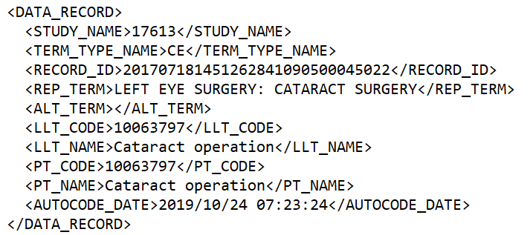
Current data model

Slide 54
Current understanding of IBM Watson training & prediction
Provide feedback
Training type (auto-encoded/coded)
Term type
Predict
Predicted dictionary code
Evaluate
Model Training
Training data object
Normalized as reported term
Predicted dictionary term
Normalized alternative term
Dictionary code
Dictionary term
Term type
Omission object
Predict
Predicted dictionary code
Send Proposal to
2nd tier Coding
Model in Production
Normalized as reported term
Predicted dictionary term
Normalized alternative term

Slide 55
Possible Model Architecture for Embedding Models
Feedback
Feedback
Pre-trained Embedding Model*
Fine-tuned Embedding Model
Coding Model
Proposals
Fine-Tuning
Prediction
Validation
*BERT based, e.g. BioBERT
Preprocessing
EHR
Clinical Trials
Text Corpora
Preprocessing
Other
Omissions
Training Data
Confirmed LLT
Test Data

Slide 56
Possible Model Architecture – Zoom-In: Preprocessing
Data
Correct Spelling Mistakes
Resolve Abbreviations
Resolve Numeric Synonyms
Preprocessing
Tokenizing
Stemming
Case conversion
Reference: Ji et al. (2019)
Preprocessed Data
Notes:
BERT-based Ranking for Biomedical Entity Normalization

Slide 57
Possible Model Architecture – Transformer Classification Model
Input
[CLS]
Token 1
Token 2
….
Token N
Fine-tuned Embedding Model
Emb
Emb
Emb
….
Emb
Coding Model
Transformer
Transformer
Transformer
Transformer
….
C
T
T
….
T
SoftMax
Classes
Proposals
Reference: Li et al. (2019)
Notes:
Fine-Tuning Bidirectional Encoder Representations From Transformers (BERT)–Based Models on Large-Scale Electronic Health Record Notes: An Empirical Study

Slide 58
Possible Model Architecture – Hybrid Classification Model
Input
Fine-tuned Embedding Model
Classes
Rule-based Candidate Class Generation
Candidate Class
As-reported term
Candidate Concept
Candidate Concept
Coding Model
[CLS]
Token 1
….
Token N
[SEP]
Token 1
….
Token N
SoftMax
Score(Term, Class)
Proposals
Reference: Ji et al. (2019)
Notes:
BERT-based Ranking for Biomedical Entity Normalization

Slide 59
Options: Future architecture
There are different options for the future coding architecture, depending on the scope
Option 1
Option 2
Option 3
Bayer In-House
Medical Coding
Solution
Bayer In-House
Medical Coding
Solution
Bayer In-House
Medical Coding
Solution
Skytree
WhoDD
Skytree
WhoDD
Skytree
WhoDD
Bayer Client
Computers
MPC Application
Server
MPC Web Server
MPC Application
Server
MPC Web Server
Illumin.ai
MPC Application
Server
MPC Web Server
Illumin.ai
Coding
Center
MPC DB
Server
with EPG
MPC DB
Server
with EPG
MPC DB
Server
with EPG
IBM Watson
Data
Center
ARGUS
SAS
Fileserver
ARGUS
SAS
Fileserver
ARGUS
SAS
Fileserver
New Bayer In-House Medical Coding is proposing solutions for both, CT and PV terms
WhoDD API is used for drug data coding
For Japanese terms, Skytree is still in place
New Bayer In-House Medical Coding is proposing solutions for CT terms only
PV data is coded via Illumin.ai system
WhoDD API is used for drug data coding
For Japanese terms, Skytree is still in place
New Bayer In-House Medical Coding is proposing solutions for CT terms only
PV data is coded via Illumin.ai system
IBM Watson is still being used for extra coding loops
WhoDD API is used for drug data coding
For Japanese terms, Skytree is still in place
New external System
New Bayer Sytem

